Slide 1
Natural language processing
Lecture 6: Attention
Roberta Rocca
Assistant Professor, IMC & CHC
✉️ roberta.rocca@cas.au.dk
Notes:
A “fractal” view on word2vec, where we start from the overall intuition, and we dive increasingly deeper into the architecture

Slide 2
Exercise
What is a hidden state in an RNN? What is it a function of?
How would you define language modeling? Why is it an important task?
Can you name a many-to-one task that can be solved with RNNs? Can you name a many-to-many task that can be solved with RNNs?
What problem(s) of RNNs do LSTMs address? How?
Notes:
25 minutes

Slide 3
Recap: RNNs
Language is sequential and temporarily ordered: temporal order carries information relevant to meaning
Approaches to modeling meaning irrespective of order (and, for words, context) miss out on important aspect of meaning
To capture these, we need architectures that encode this sequential structure and the contextualized nature of language
Recurrent neural networks are the kind of architecture we are after
RNNs apply the same sets of parameters recursively to the input
While doing so, they propagate hidden states that sequentially accumulate information about the sequence
Notes:
i.e., stacked collections of "perceptrons" that independently apply linear transformations to their inputs, sum the results of these linear transformations, and then apply a non-linearity

Slide 4
Recap: language modeling
Language modeling is the task of predicting the next word in a sequence
… technically, this is forward language modeling, as opposed to masked language modeling, where parts of the sequence are removed or corrupted
It is a task where sequential information can be very important (e.g., as information gets updated over the sequence, and because of syntactic constraints)
Solving language modeling requires rich semantic, syntactic, and some world knowledge
It is therefore a great proxy for generalized language knowledge, and a task that is used to train the vast majority of models these days (also models doing other tasks! – more on that next week)
RNNs are the first architecture we see that is fit to doing language modeling
Notes:
i.e., stacked collections of "perceptrons" that independently apply linear transformations to their inputs, sum the results of these linear transformations, and then apply a non-linearity

Slide 5
Recap: LSTMs
Yet, RNNs suffer greatly from vanishing gradients and, relatedly, are unable to model long-term dependencies in linguistic input
How can we make these models more resilient to information loss over long time spans?
Long short-term memory models (LSTMs) are a solution to this: they maintain memory through controlled information flows, regulated by:
A forget gate
An input gate
An output gate
These architectures are able to better retain information over several time steps, and suffer much less from vanishing gradients
Notes:
i.e., stacked collections of "perceptrons" that independently apply linear transformations to their inputs, sum the results of these linear transformations, and then apply a non-linearity

Slide 6
Residual issues with RNNs/LSTMs
RNNs only propagate one hidden state (a vector), which severely limits the amount of information that can models can encode
This limitation in information capacity is called the information bottleneck
Sometimes, this removes or “blurs” information which is required to perform a certain task

Slide 7
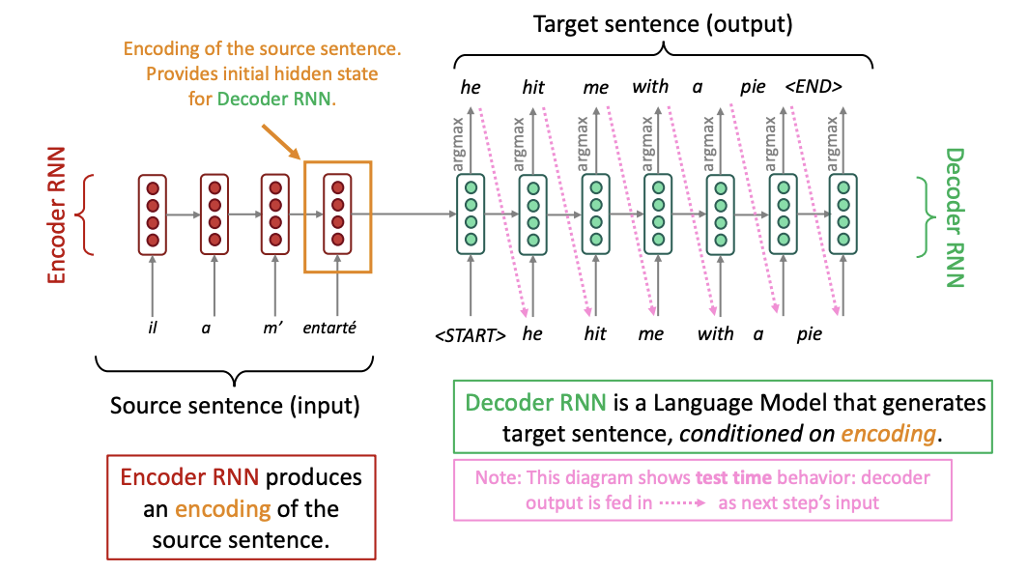
Example: neural machine translation
A sequence-to-sequence model
Here, there is generally a FNN with softmax activation
Notes:
Machine translation is not trivial

Slide 8
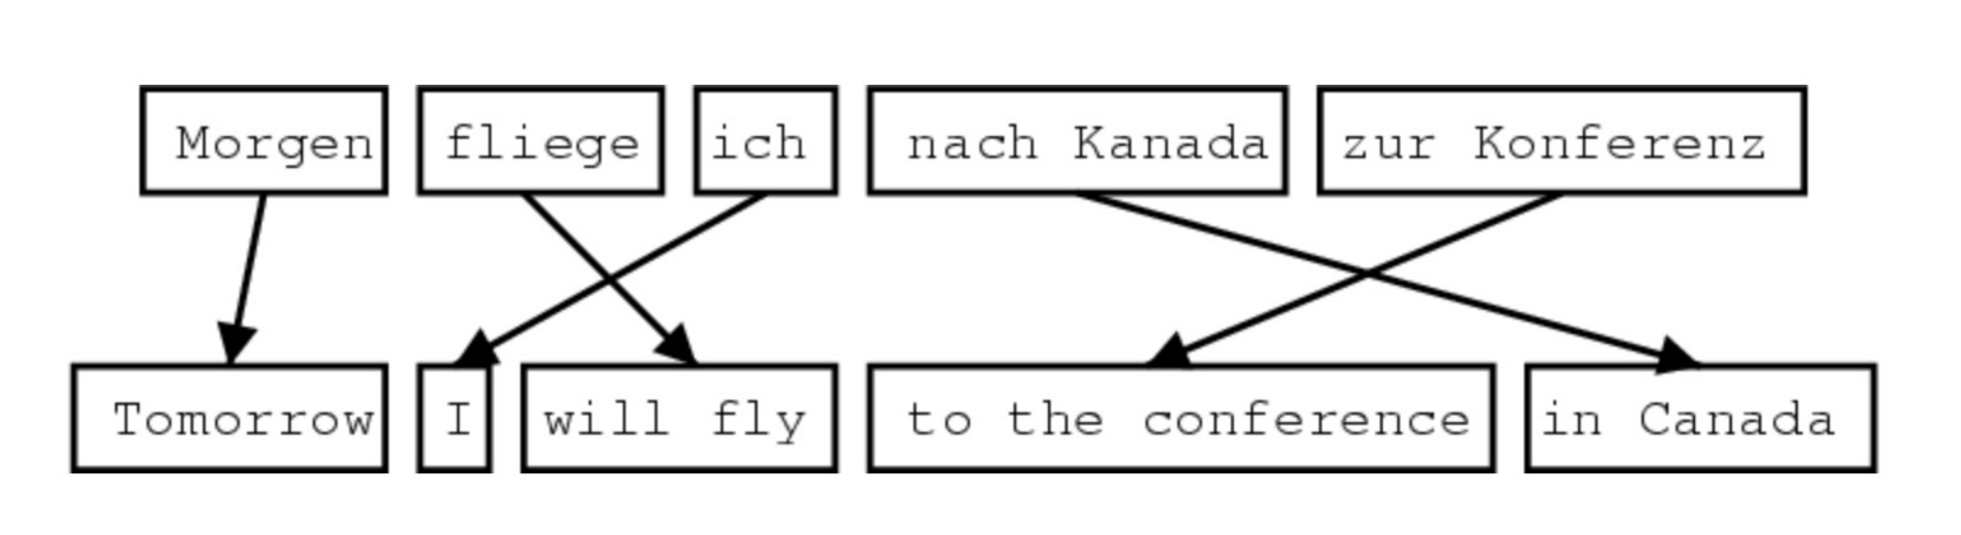
Example: machine translation
Translation relies on accessing information about different parts of the sequence at different times, and the order of the translated sequence is not the same as the source sequence
Notes:
Machine translation is not trivial – excellent example of the importance of accessing info at a certain time, also domain in which the approach we will look into in a second was developed

Slide 9
Example: language modeling
“I was born in France and grew up there, my parents were winemakers from the Southern part of the country. I only recently moved to Denmark, to start an undergraduate programme in Cognitive Science. I speak fluent English and French ”
“I was born in France and grew up there, my parents were winemakers from the Southern part of the country. I only recently moved to Denmark, to start an undergraduate programme in Cognitive Science. I speak fluent English and French”
Similar considerations apply to language modeling: different bits of information are relevant for predictions at different steps.
Notes:
Machine translation is not trivial

Slide 10
Example: neural machine translation
A sequence-to-sequence model
Here, there is generally a FNN with softmax activation
Notes:
Machine translation is not trivial

Slide 11
Q: how do we enable this model to use information about about specific, relevant words appearing earlier in the sequence to produce better predictions at a given time?
Notes:
Machine translation is not trivial

Slide 12



From memory to attention
cook
recipe
read
Notes:
i.e., stacked collections of "perceptrons" that independently apply linear transformations to their inputs, sum the results of these linear transformations, and then apply a non-linearity

Slide 13

From memory to attention
cook
recipe
read
Notes:
i.e., stacked collections of "perceptrons" that independently apply linear transformations to their inputs, sum the results of these linear transformations, and then apply a non-linearity

Slide 14
So what is attention in neural networks?
Attention involves accessing representations of specific words in the sequence to compute some “relevance weights”
These weights tell the model how much representations of previous words should inform its computations at a given stage
A weighted sum of representations of previous states is then concatenated with or added to the current state, to incorporate relevant previous information in current computations
Notes:
What does it mean to attend to information? How are these relevance scores computed?

Slide 15
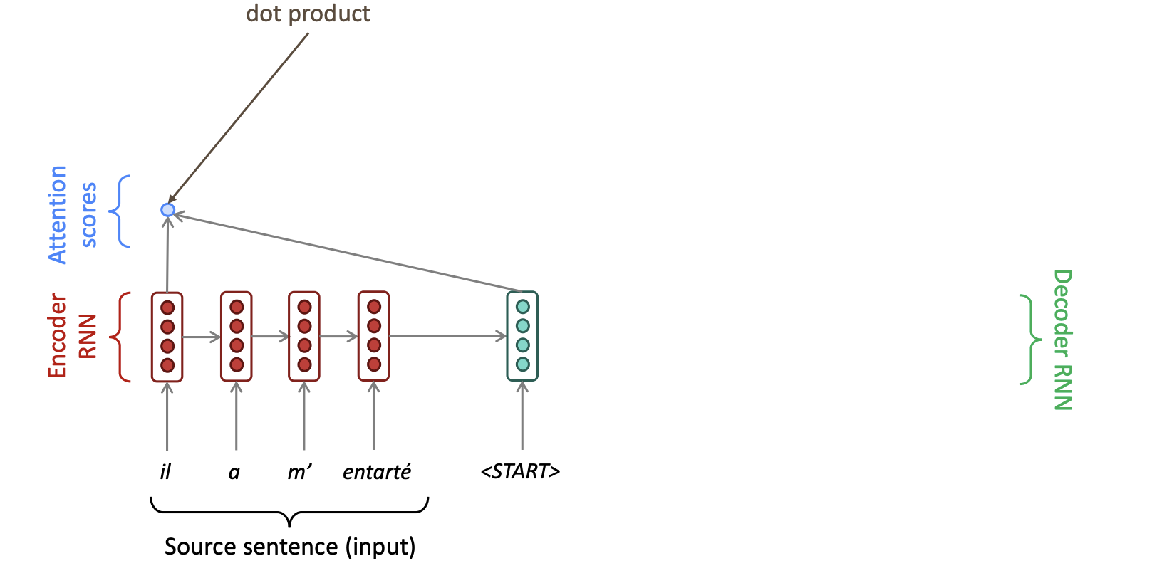
Attention in a seq2seq NMT model
Notes:
i.e., stacked collections of "perceptrons" that independently apply linear transformations to their inputs, sum the results of these linear transformations, and then apply a non-linearity

Slide 16
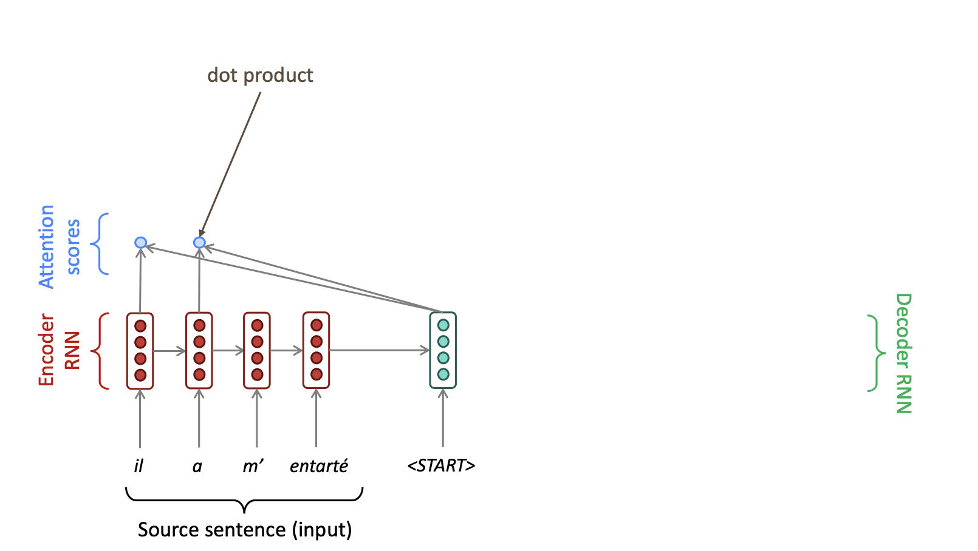
Attention in a seq2seq NMT model
Notes:
i.e., stacked collections of "perceptrons" that independently apply linear transformations to their inputs, sum the results of these linear transformations, and then apply a non-linearity

Slide 17
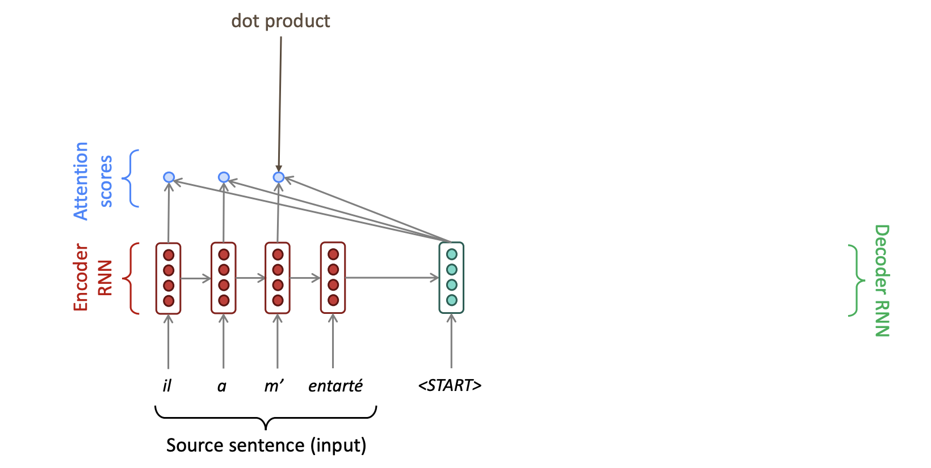
Attention in a seq2seq NMT model
Notes:
i.e., stacked collections of "perceptrons" that independently apply linear transformations to their inputs, sum the results of these linear transformations, and then apply a non-linearity

Slide 18
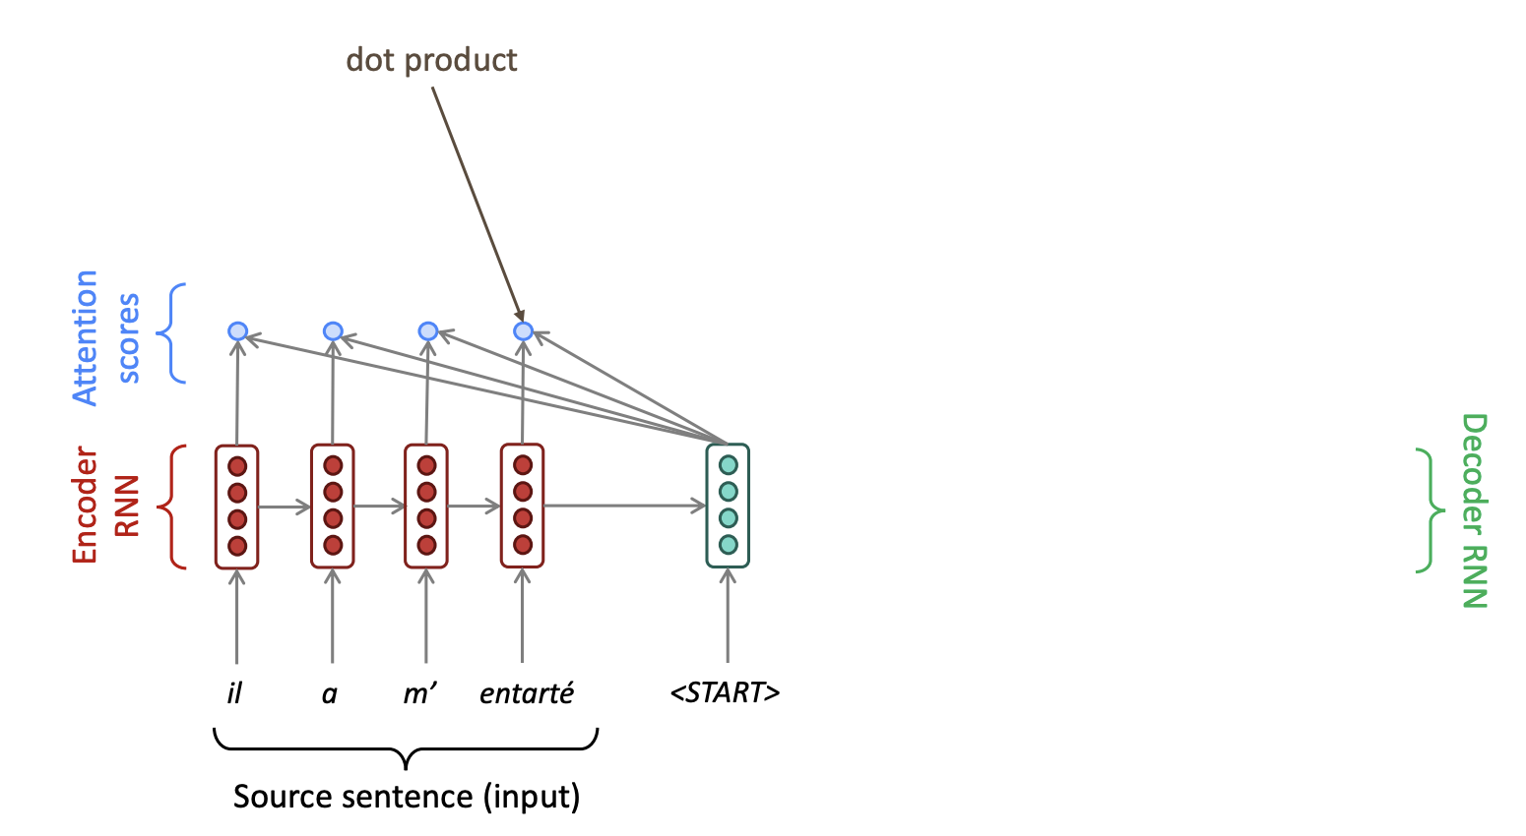
Attention in a seq2seq NMT model
Notes:
i.e., stacked collections of "perceptrons" that independently apply linear transformations to their inputs, sum the results of these linear transformations, and then apply a non-linearity

Slide 19
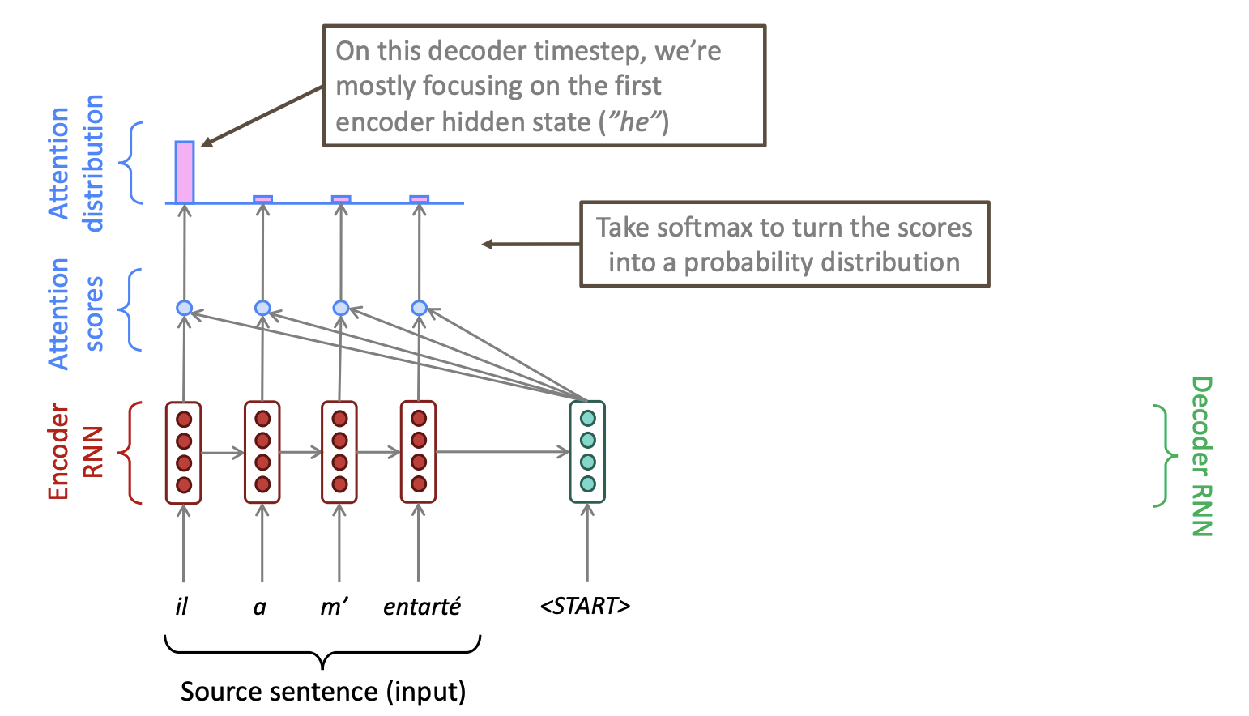
Attention in a seq2seq NMT model
Notes:
Softmax of the hidden states

Slide 20
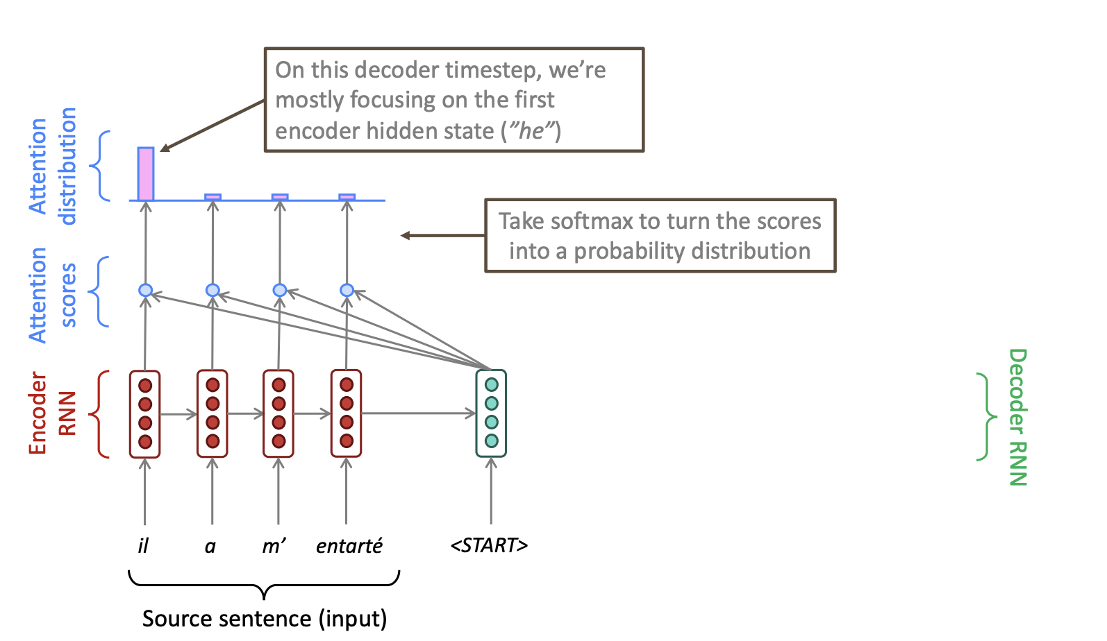
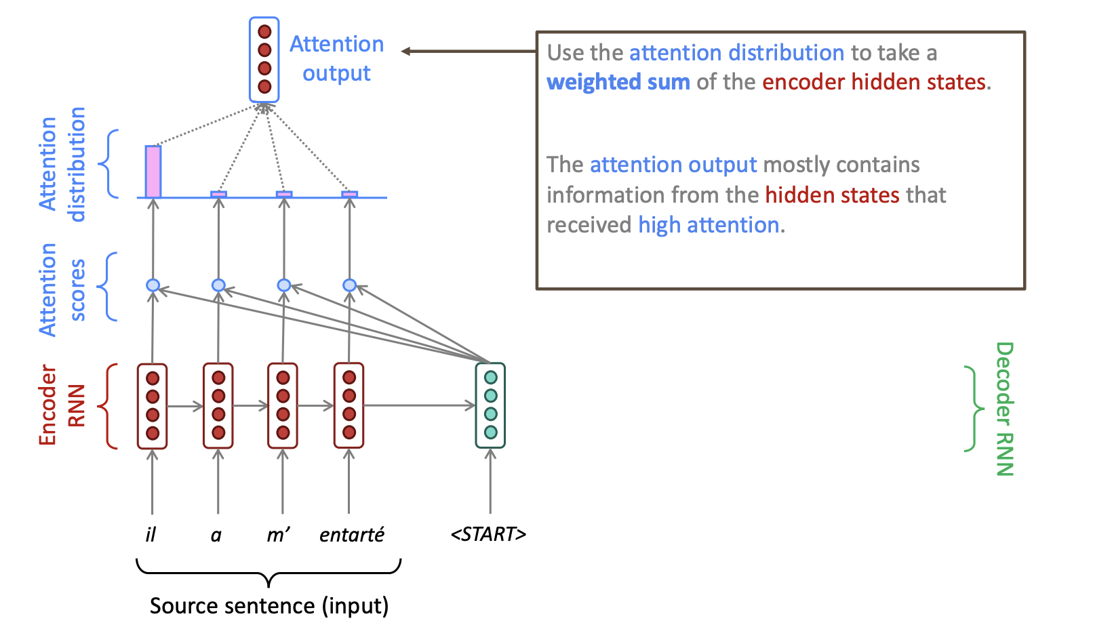
Attention in a seq2seq NMT model
Notes:
Softmax of the hidden states

Slide 21
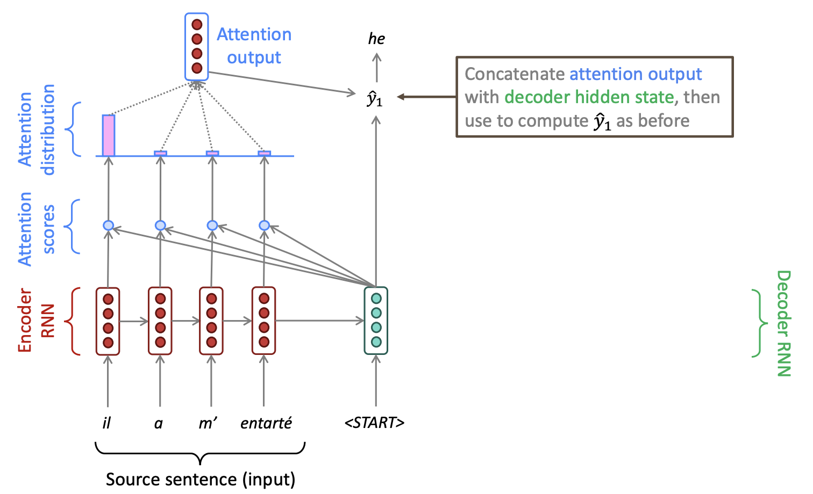
Attention in a seq2seq NMT model
Notes:
There is a FFN doing a softmax transformation in the output…?

Slide 22
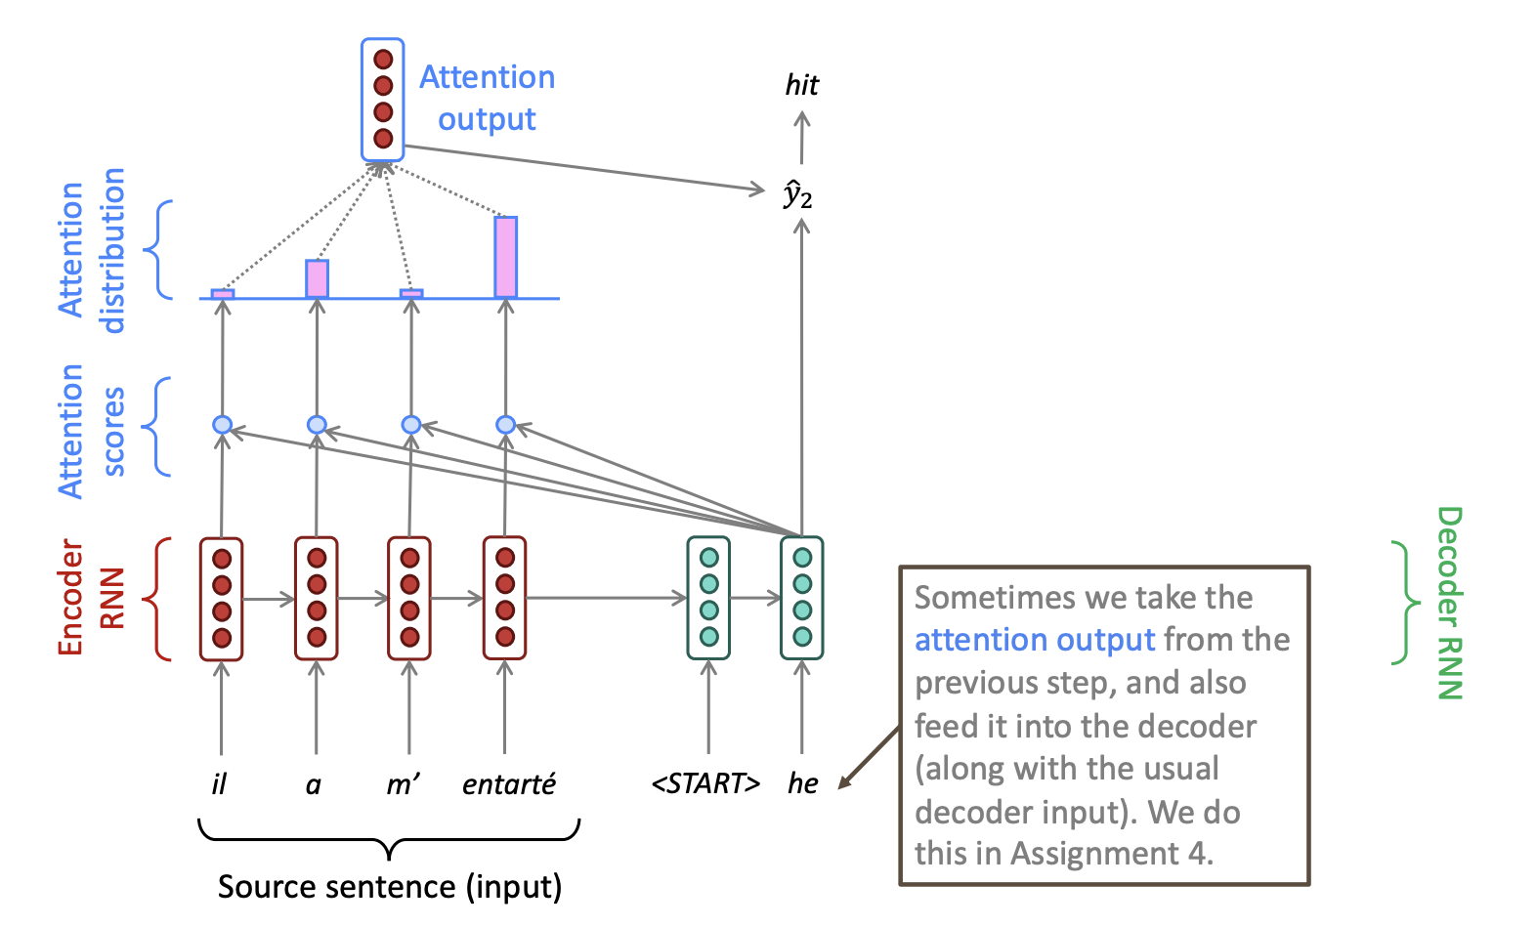
Attention in a seq2seq NMT model
Notes:
Softmax of the hidden states

Slide 23
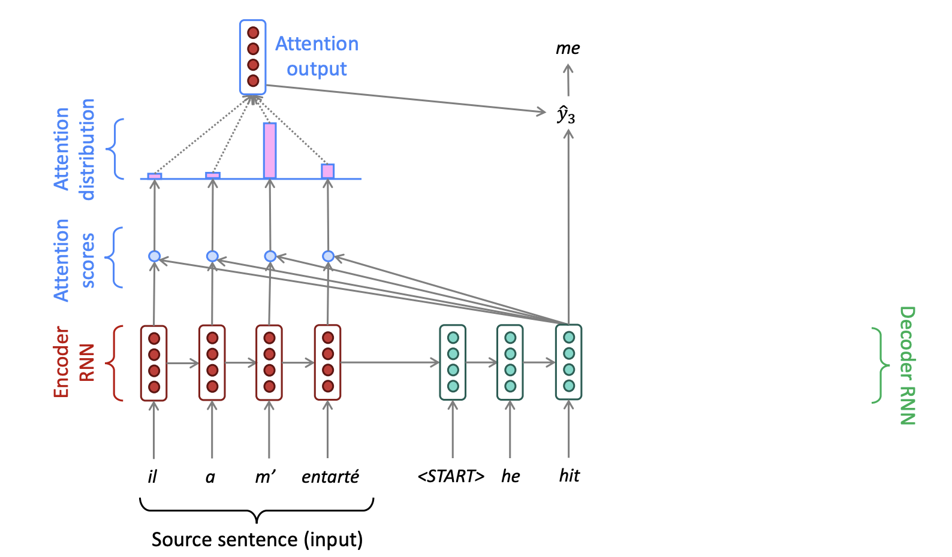
Attention in a seq2seq NMT model
Notes:
Softmax of the hidden states

Slide 24
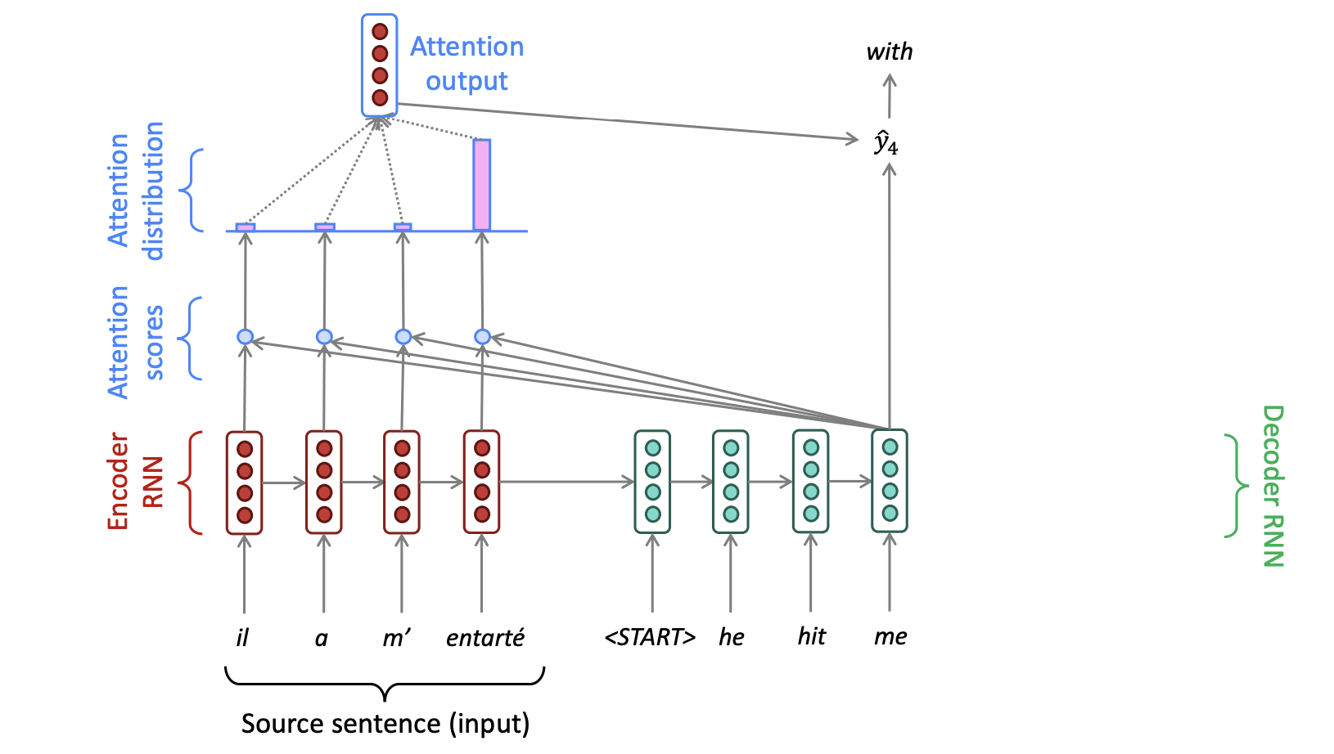
Attention in a seq2seq NMT model
Notes:
Softmax of the hidden states

Slide 25
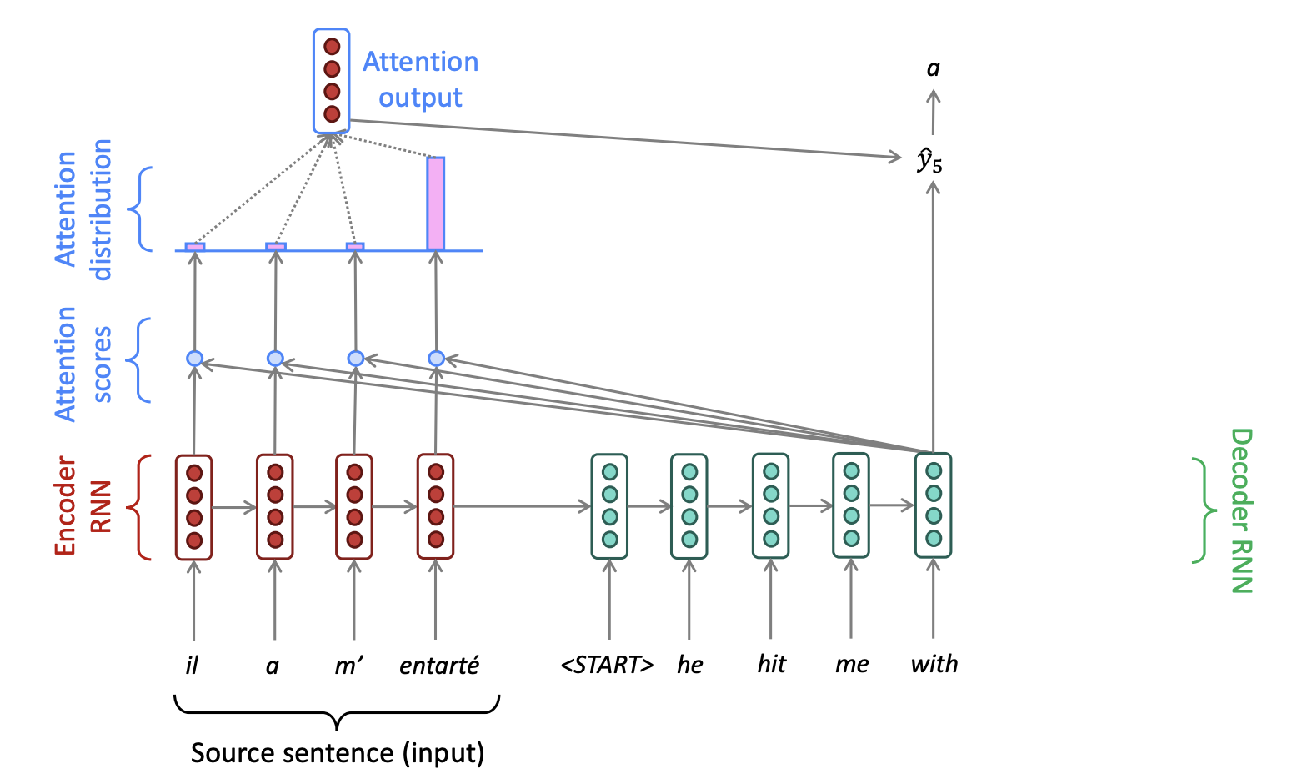
Attention in a seq2seq NMT model
Notes:
Softmax of the hidden states

Slide 26
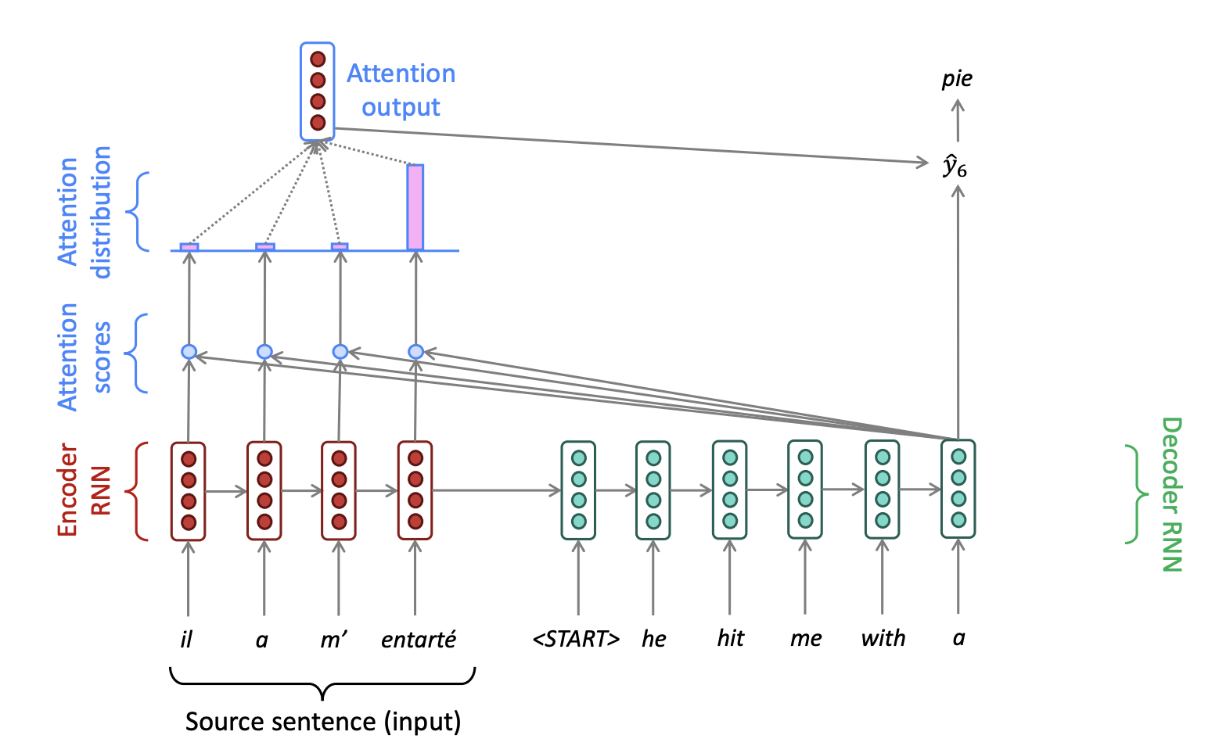
Attention in a seq2seq NMT model
Notes:
Softmax of the hidden states

Slide 27
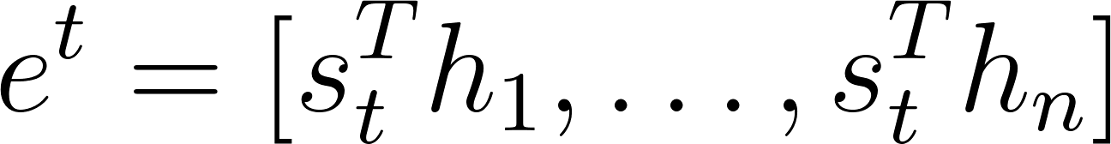
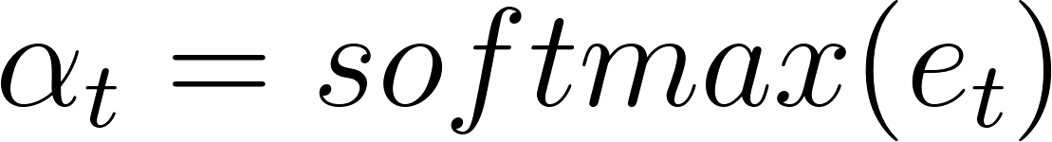
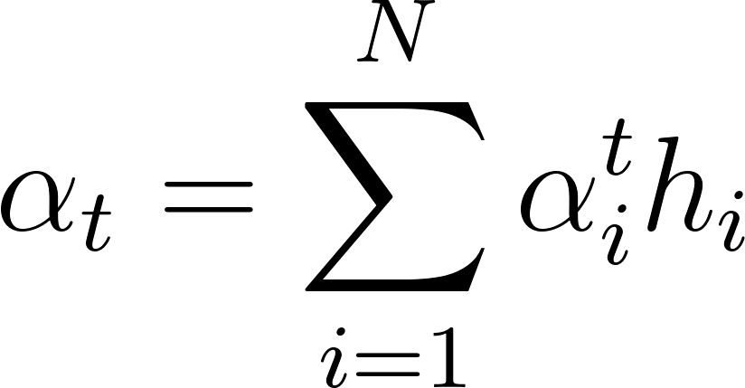
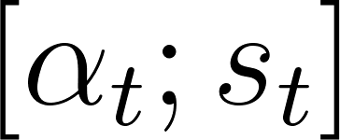
Attention in a seq2seq NMT model
We have encoder hidden states h₁, …, h_{N} (these are vectors)
On timestep t, we have decoder hidden state s_{t}
We get attention scores for this step
We compute softmax to get attention distribution (this is a probability distribution that sums to 1)
We use that to create a weighted sum of encoder hidden states and get an attention output
We concatenate the attention output with the decoder hidden state and produce predictions for the next word
Notes:
For the mathy types… remember the dot product?

Slide 28
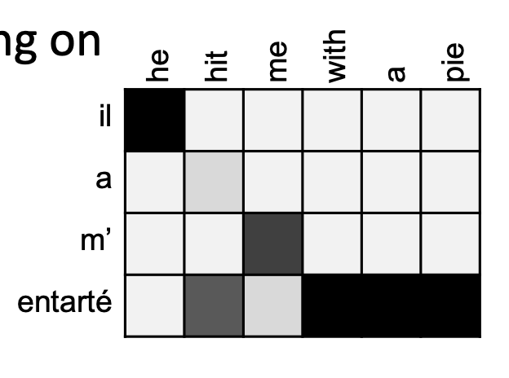
The importance of attention
Attention is an extremely successful approach in NMT, as it allows the model to dynamically retrieve information from previous relevant parts of the sequence
Solves the bottleneck problem
Helps with vanishing gradients by providing direct access to faraway states
Provides some interpretability, as you can inspect attention weights
Notes:
For the mathy types

Slide 29
Other applications
Attention is not only relevant for machine translation
Think about our language modeling example:
“I was born in France and grew up there, my parents were winemakers from the Southern part of the country. I only recently moved to Denmark, to start an undergraduate programme in Cognitive Science. I speak fluent English and French ”
“I was born in France and grew up there, my parents were winemakers from the Southern part of the country. I only recently moved to Denmark, to start an undergraduate programme in Cognitive Science. I speak fluent English and French”
Notes:
Developed originally for machine translation…

Slide 30
Other applications
Attention is not only relevant for machine translation
Think about our language modeling example
Can we augment language modeling with attention?
For language modeling, we don’t need two architectures: whenever we attend to tokens from the same sequence / module, we talk about self-attention
Notes:
Two functions for this example: try it out with language modeling

Slide 31
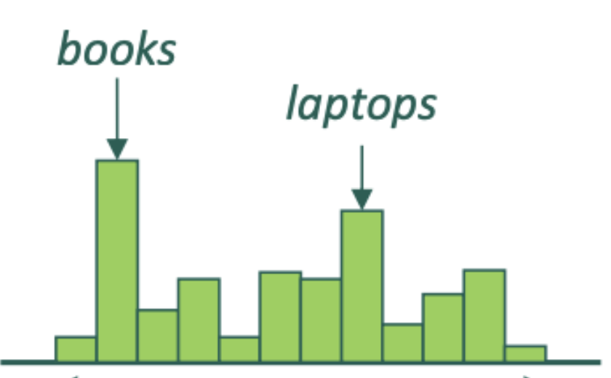
Language modeling with simple self-attention
y₁
y₂
y₃
y₄
x₁
x₂
x₃
x₄
the
students
opened
their
Notes:
For the mathy types

Slide 32
Language modeling with simple self-attention
h₄
get attention weights
weighted sum of the hidden states
compute dot product
concatenate with h₄
Q: is this optimal?
x₁
x₂
x₃
x₄
the
students
opened
their

Slide 33
Another issue with RNNs/LSTMs
Both RNNs and LSTMs operate sequentially, which limits their computational efficiency
Computations cannot be parallelized (as hidden states from previous steps are required)
This means that time complexity grows as a function of sequence length!

Slide 34
Language modeling without recursion?
Q: Can we build an architecture for LM that does without recursion?
Relies on static representations of inputs (i.e., not obtained through recursive computations)?
Simultaneously performs language modeling (predicting the next word, given past context) on the entire sequence, avoiding recurrence and its computational disadvantages
Leverages attention, making it possible to dynamically access information from previous states, avoiding the information bottleneck
-> Attention is all you need! (Vaswani et al., 2017)

Slide 35
Some terminology
A query is a representation we want to “update”, based on information from other parts of the input (in our NMT model, that would be the hidden state of the decoder; for LM, it is each token in the sequence)
A key is a representation we “compare” the query to, to obtain attention weights (in NMT, the hidden states of the encoder; for LM, all previous tokens)
A value is a representation we multiply by the attention weights (in NMT, this is the hidden states of the encoder; for LM, this is all previous tokens)
In language modeling, query, key, and value are the slightly transformed representations of the same input

Slide 36
Schematic representation of what we want
probability distribution for what the next word may be
FFN with softmax
FFN with softmax
FFN with softmax
FFN with softmax
representation of each token in the sequence informed by all previous tokens in the sequence through attention
y₁
y₂
y₃
y₄
self-attention
“static” representation of each input token: each token is transformed into a vector based on some independent transformation (e.g., embeddings, multiplication by fixed weights, etc)
x₁
x₂
x₃
x₄
the
students
opened
their
Notes:
Mention sampling

Slide 37
Q: how does this mechanism work in practice?
Notes:
Machine translation is not trivial

Slide 38
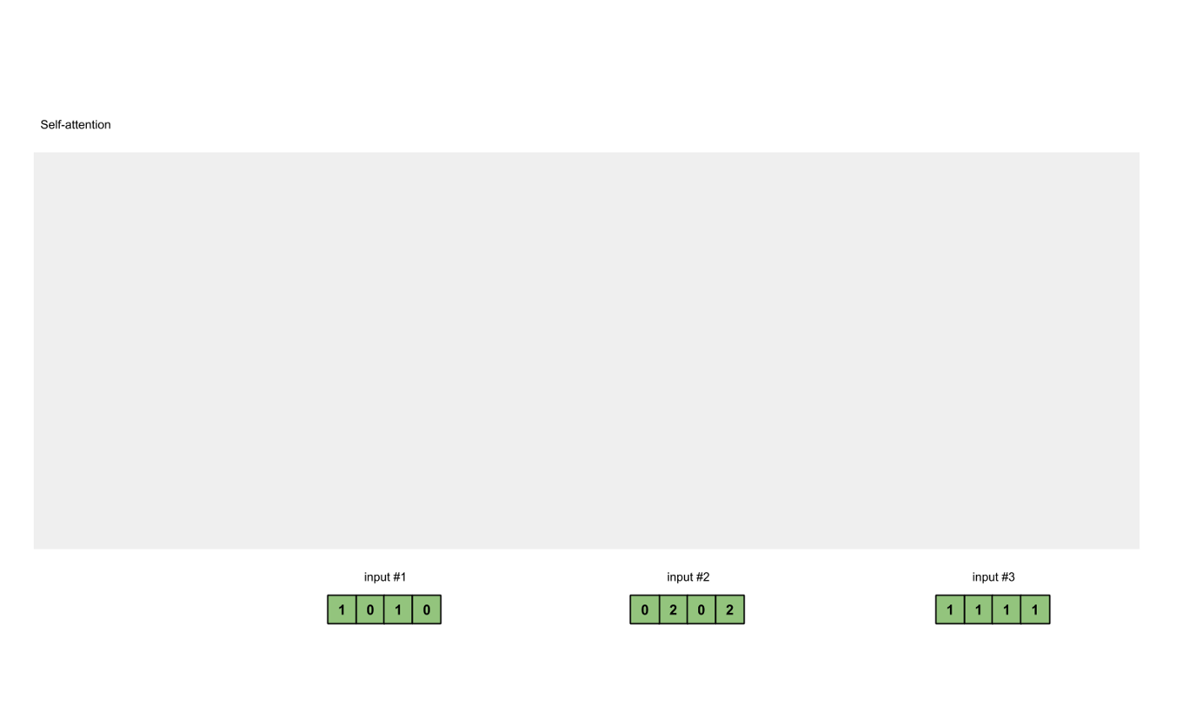
Initialize input
The first thing we do is that we initialize each of our input as a embedding vectors
In this example, we use 3 inputs
(i.e., three words) whose initial embedding has dimensionality 4
Input 1 = [1, 0, 1, 0]
Input 2 = [0, 2, 0, 2]
Input 3 = [1, 1, 1, 1]
This is just a word embedding

Slide 39
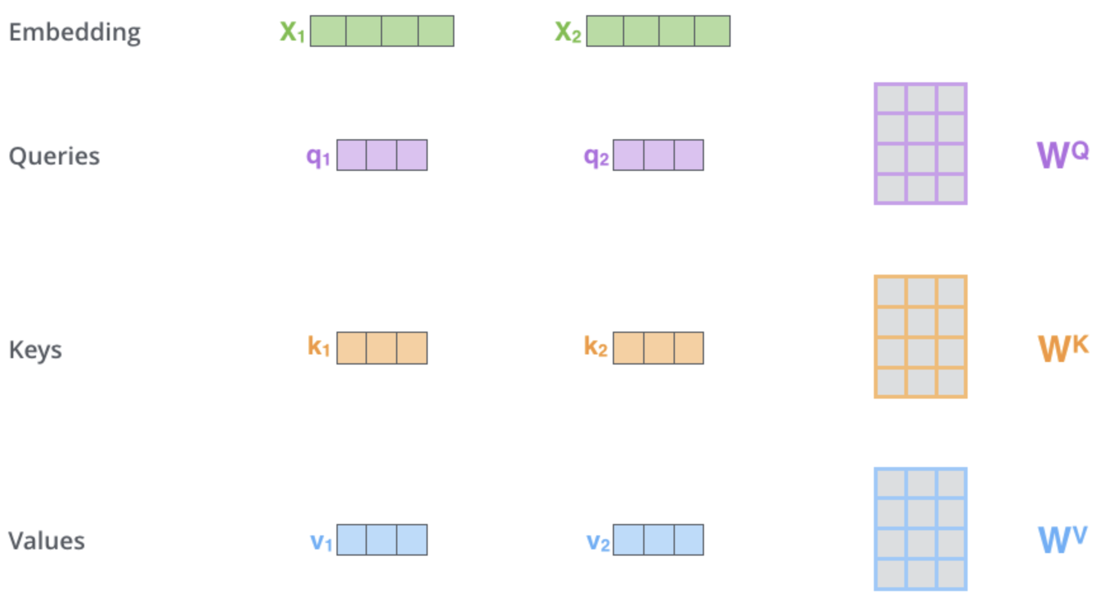
2. Initialize weights
The input is projected into three separate vectors: a query, a key, and a value
This is done by multiplying the input by a weight matrix (which can also alter, e.g., reduce, the dimensionality of the input)
We have three weight matrices (learnable parameters): Q, K, V
From Alammar (2018)

Slide 40
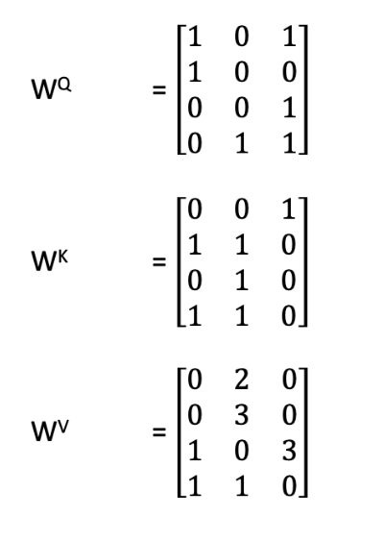
3. Get Q,K,V vectors
In this example, the weight matrices are
From Karim (2019)

Slide 41
4. Calculate attention scores
To obtain attention scores, we simply take the dot product between the query from Input 1 (red) and all of the keys (orange)
Since there are 3 key representations, we obtain 3 attention scores (blue)
Notice how we get the dot product between the query and key for input 1, too
From Karim (2019)

Slide 42
5. Softmax and multiply
We then run all of the scores through a softmax function
softmax([2,4,4]) = [0.0, 0.5, 0.5]
These are the attention weights, which we then multiply by the value vectors, creating weighted values
From Karim (2019)

Slide 43
6. Sum weighted values
Lastly, we take all weighted values (yellow), and sum them element-wise
The resulting vector (dark green) is based on the query representation from Input 1, interacting with all other keys (including itself)
From Karim (2019)

Slide 44
7. Repeat for remaining inputs
We then repeat the same steps for the subsequent inputs
Notice how in each case we are calculating attention and output vectors for each position independently
In practice, this is done simultaneously as matrices
Notice also that we there is no hidden state coming from an output network either
So we’re using self-attention to learn output embeddings from our inputs directly – no more hidden state passed along the chain
No more recurrent neural network!
From Karim (2019)

Slide 45

Language modeling with self-attention
Let’s look at the actual computations in matrices
Let X = [x₁; … ; x_{T}] be a matrix of input vectors (dimension: T x d)
Let K, Q, and V be the weight vectors, through which we project the input into key, query, and vector values (we assume dimensionality d)
The output of a self-attention layer is:
Attention weights (T x T)
Notes:
Row x column -> then same row to same column (but go one further in the column matrix)
Softmax is applied across

Slide 46
Residual issues
In this example, words in the future inform language modeling

Slide 47
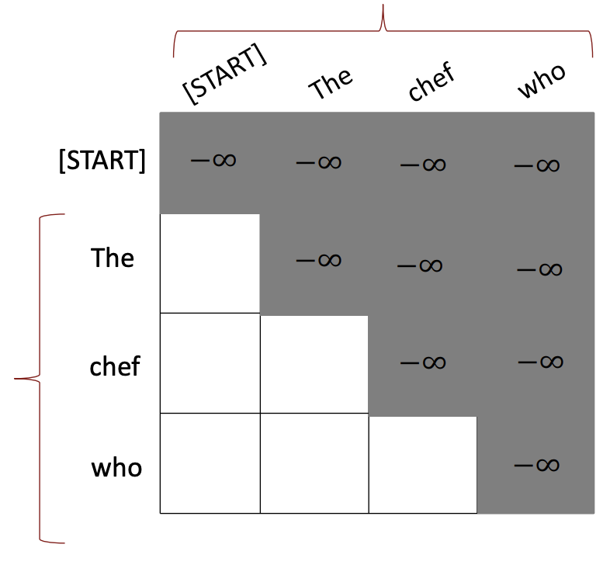
Masking future tokens
To prevent a model from accessing information in the future, we mask attention weights (before normalization) by setting weights for future tokens to -Inf
When plugging -Inf into a softmax, that makes the weight zero
This allows the model to perform forward language modeling

Slide 48
Residual issues
In this example, words in the future inform language modeling
This approach does not have any notion of order! How do we restore a notion of order in here?

Slide 49
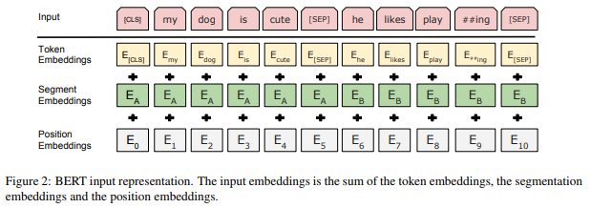
Encoding position
In practice, input tokens are augmented with position embeddings: these can be absolute positional embeddings, or less “rigid” forms of positional embedding

Slide 50
Residual issues
In this example, words in the future inform language modeling
This approach does not have any notion of order! How do we restore a notion of order in here?
Everything we do here is linear! How can we introduce non-linearities
Can attend to information in multiple ways?
-> A transformer block is not just self-attention

Slide 51
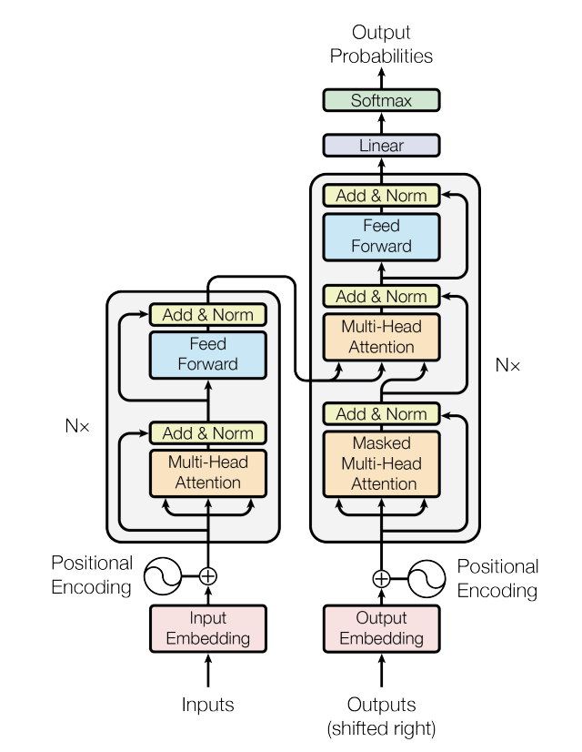
The transformer architecture
Self-attention is the basic building block of transformers
Transformers are made up of stacked transformer blocks, each of which involves attention and a few additional calculations
There are different types of transformers: encoder only (BERT), decoder only (GPT), and encoder-decoder (the original transformer)

Slide 52
The transformer architecture
Transformers apply attention multiple times in parallel, learning different attention weights (multi-headed attention)
Note that the transformer uses scaled dot-product rather than simple dot-product
We will dive deeper into the transformer(s) and its importance next week!

Slide 53
Summary
RNNs and LSTMs suffer from the information bottleneck and their recurrent nature is computationally inconvenient
Attention improves our ability to access information from previous parts of the sequence in a nuanced and task-relevant fashion
(Self-)Attention involves computing weights that tell us how much representations from previous time steps should be attended to, in order to efficiently perform a task at a given step (e.g., producing the next word in a translation or in language modeling)
These weights are calculated using some (comparatively simple) maths combined together in increasingly complex architectures
The output of these computations is contextualized representations of a sequence at a given steps (aka, contextualized representations of a given token)
Attention involves no sequential dependencies: it allows us to efficiently model sequences and their internal dependencies in parallel (it’s just matrix multiplication all down the line)
We can apply a few tricks to model order (positional encodings), or mask future tokens for language generation or forward language modeling tasks
(Self-)attention is the basic building block of the transformer an extremely successful NLP architecture: more next week!

Slide 54
Language modeling with self-attention
While RNNs produce somewhat contextualized representations of words, it is hard to distinguish between word and sentence-level representations
Language modeling with self-attention provides more clearly contextualized token-level representations
In general, language modeling is an excellent way to learn information about language in a self-supervised fashion (to do LM, you need a good idea of how language works)
The representations learned by transformers through LMs turn out to be an excellent starting point for most NLP tasks (we will talk about transfer learning next week)
Notes:
For the mathy types

Slide 55
See you tomorrow!

Slide 56
Additional reading
Bahdanau, D., Cho, K., & Bengio, Y. (2015). ‘Neural machine translation by jointly learning to align and translate’, ICLR 2015.
Graves, A., Wayne, G., Danihelka, I. (2014). ‘Neural turing machines’, arXiv:1410.5401
Luong, T., Pham, H., Manning, C.D. (2015). ‘Effective Approaches to Attention-based Neural Machine Translation.’ EMNLP 2015.
Vaswani, A., Shazeer, N., Parmar, N., Uszkoreit, J., Jones, L., Gomez, A.N., Kaiser, Ł., Polosukhin, I. (2017). ‘Attention is all you need’, Advances in neural information processing systems, 5998-6008
Blogs
Arbel, N. (2019). ‘Attention in RNNs’, https://medium.datadriveninvestor.com/attention-in-rnns-321fbcd64f05
Karpathy, A. (2015). ‘The Unreasonable Effectiveness of Recurrent Neural Networks’, https://karpathy.github.io/2015/05/21/rnn-effectiveness/
Weng, L. (2018). ‘Attention? Attention!’, https://lilianweng.github.io/lil-log/2018/06/24/attention-attention.html

Slide 57
Additional reading
Cheng, J., Dong, L., & Lapata, M. (2016). ‘Long Short-Term Memory Networks for Machine Reading’, https://arxiv.org/pdf/1601.06733.pdf
Blogs
Alammar, J. (2018). ‘The Illustrated Transformer’, https://jalammar.github.io/illustrated-transformer/
Karim, R. (2019). ‘Illustrated: Self-Attention’, https://towardsdatascience.com/illustrated-self-attention-2d627e33b20a
Kazemnejad, A. (2019). ‘Transformer Architecture: The Positional Encoding’, https://kazemnejad.com/blog/transformer_architecture_positional_encoding/
Weng, L. (2018). ‘Attention? Attention!’, https://lilianweng.github.io/lil-log/2018/06/24/attention-attention.html

